Slide 1


Introduction to Piezoelectric Sensors
This presentation provides an introduction to piezoelectric sensors, covering their working principles, materials, applications, and future trends.
by swaraj

Slide 2
Piezoelectric Effect: Direct and Converse
Direct Piezoelectric Effect
Converse Piezoelectric Effect
When a piezoelectric material is subjected to mechanical stress, it generates an electrical charge. The voltage produced is proportional to the applied stress.
Applying an electric field to a piezoelectric material induces mechanical deformation, either expansion or contraction. The strain is proportional to the applied voltage.

Slide 3

Working Principle of Piezoelectric Sensors
1
Mechanical stress applied to the sensor causes the piezoelectric material's crystal lattice to deform, altering the alignment of electric dipoles.
2
This deformation leads to charge separation, with positive charges accumulating on one surface and negative charges on the other.
3
The sensor's electrodes collect the accumulated charge, generating an electrical signal proportional to the applied pressure or force.

Slide 4
Types of Piezoelectric Materials
Natural Materials
Synthetic Materials
Quartz is the most common, known for stability and high-frequency applications. Tourmaline exhibits pyroelectric and piezoelectric properties.
PZT offers high sensitivity, making it ideal for actuators and transducers. PVDF is flexible, enabling its use in biomedical applications.

Slide 5
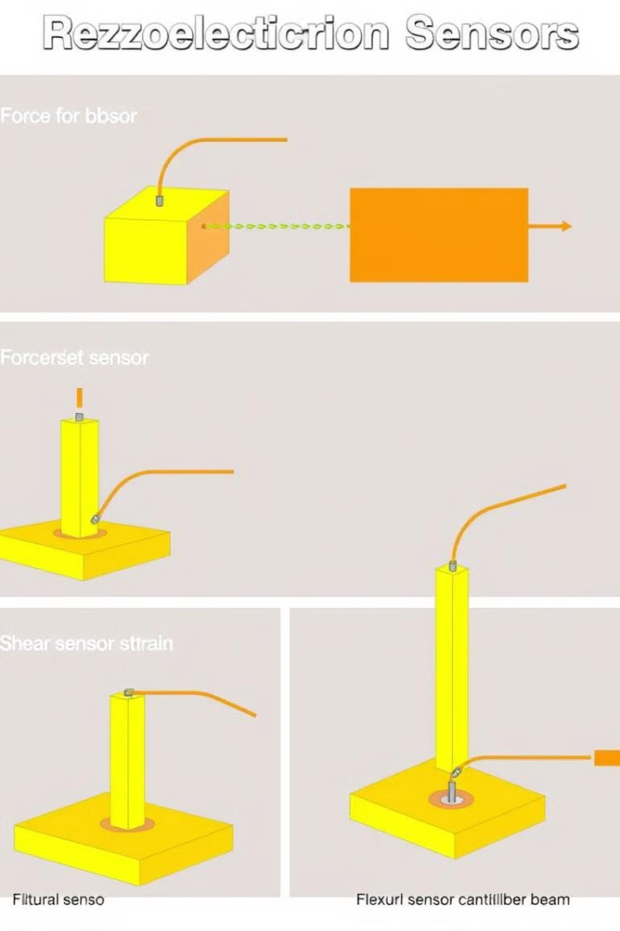



Sensor Configurations and Signal Conditioning
Compression sensors measure pressure, ideal for high-pressure applications like industrial process control.
Shear sensors detect acceleration, commonly used in vibration monitoring and seismology.
Flexural sensors measure displacement, useful in applications like robotics and medical devices.

Slide 6

Applications of Piezoelectric Sensors
Pressure Sensors
Automotive, medical devices, and industrial process control rely on piezoelectric pressure sensors for precise measurements.
Force Sensors
Robotics and biomechanics utilize force sensors to measure forces, enabling precise control and analysis of movements.
Accelerometers
Consumer electronics, vibration monitoring, and seismology utilize accelerometers to detect changes in motion and acceleration.
Ultrasonic Transducers
Medical imaging and non-destructive testing utilize ultrasonic transducers for generating and detecting sound waves, providing detailed information about internal structures.

Slide 7
Advantages and Limitations
Advantages
Limitations
Piezoelectric sensors offer high sensitivity, fast response, wide frequency range, self-generation, and compact design.
They exhibit sensitivity to temperature variations, charge leakage, and are limited for static measurements due to charge decay.

Slide 8

Conclusion and Future Trends
1
Piezoelectric sensors offer a unique combination of sensitivity, speed, and self-generation, making them valuable in various applications.
2
Integration with MEMS technology, use in energy harvesting, and development of lead-free piezoelectrics are promising areas for future research and development.
3
The growing IoT and wearable device markets will likely drive further advancements and wider adoption of piezoelectric sensors.

